Slide 1

Lecture
on
“Advanced Computer Architecture –TCS 704”
by
Akansha Gupta
DEPARTMENT OF COMPUTER SCIENCE AND ENGINEERING
GRAPHIC ERA DEEMED TO BE UNIVERSITY – 248002

Slide 2
Fully Associative Mapping

Slide 3
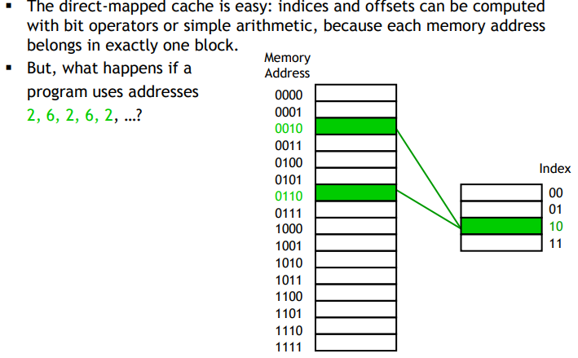
Disadvantage of direct mapping

Slide 4
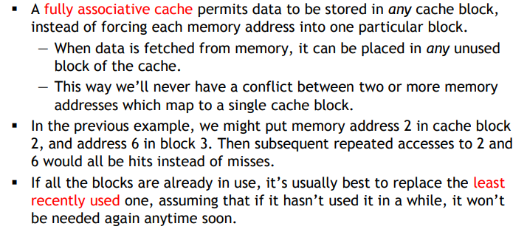
A fully associative cache

Slide 5
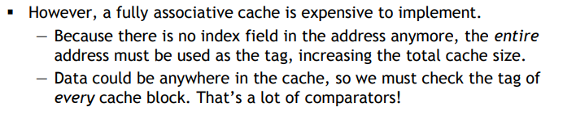
The price of full associativity

Slide 6
Need of Replacement Algorithm
In fully associative mapping,
A replacement algorithm is required.
Replacement algorithm suggests the block to be replaced if all the cache lines are occupied.
Thus, replacement algorithm like FCFS Algorithm, LRU Algorithm etc is employed.

Slide 7
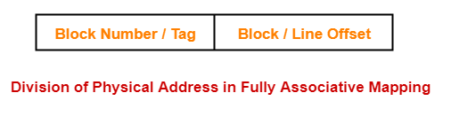
Division of Physical Address
In fully associative mapping, the physical address is divided as-

Slide 8
PRACTICE PROBLEMS BASED ON FULLY ASSOCIATIVE MAPPING

Slide 9
Problem-01:
Consider a fully associative mapped cache of size 16 KB with block size 256 bytes. The size of main memory is 128 KB. Find-
Number of bits in tag
Tag directory size

Slide 10
Solution-
Given-
Cache memory size = 16 KB
Block size = Frame size = Line size = 256 bytes
Main memory size = 128 KB
We consider that the memory is byte addressable.

Slide 11
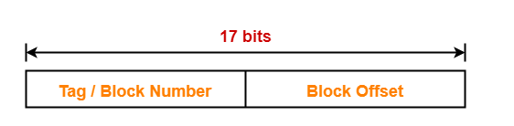
Number of Bits in Physical Address-
We have,
Size of main memory
= 128 KB
= 2¹⁷ bytes
Thus, Number of bits in physical address = 17 bits

Slide 12
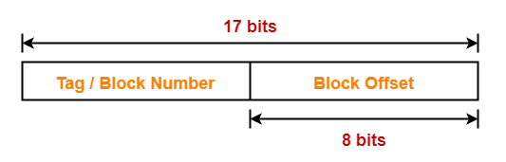
Number of Bits in Block Offset-
We have,
Block size
= 256 bytes
= 2⁸ bytes
Thus, Number of bits in block offset = 8 bits

Slide 13
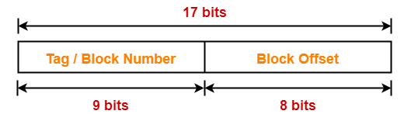
Number of Bits in Tag-
Number of bits in tag
= Number of bits in physical address – Number of bits in block offset
= 17 bits – 8 bits
= 9 bits
Thus, Number of bits in tag = 9 bits

Slide 14
Number of Lines in Cache-
Total number of lines in cache
= Cache size / Line size
= 16 KB / 256 bytes
= 2¹⁴ bytes / 2⁸ bytes
= 2⁶ lines
Tag Directory Size-
Tag directory size
= Number of tags x Tag size
= Number of lines in cache x Number of bits in tag
= 2⁶ x 9 bits
= 576 bits
= 72 bytes
Thus, size of tag directory = 72 bytes

Slide 15
https://youtu.be/Arab5Kd_2r8
THANKS

